Slide 1
Creating a Socket Server
All in C with all the joys that come with it!

Slide 2
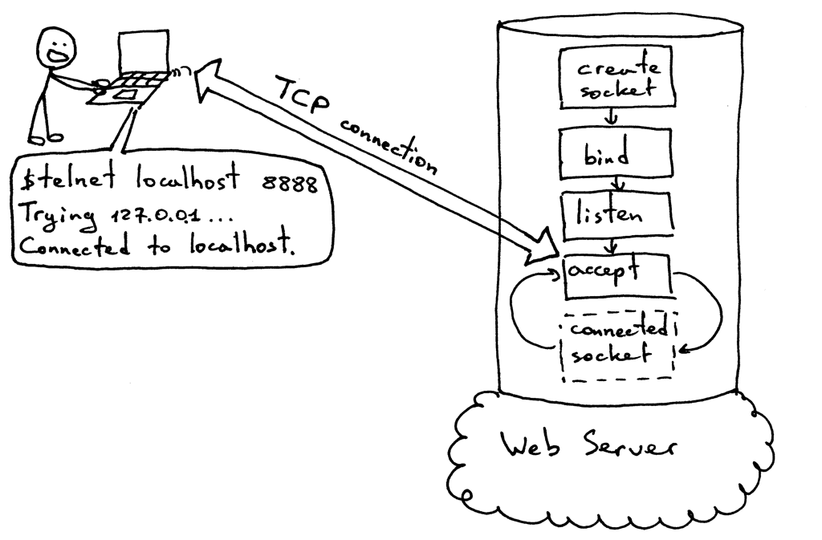

Slide 3
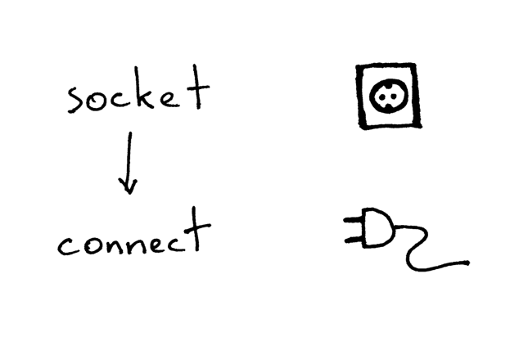

Slide 4
